Slide 1
Security Issue Mitigation

Slide 2
Recommendations for Blue Ink
Martin Ponce, ID 10371381
CSI1101 Computer Security
ES Off-Campus
Tutor: Patryk Szewczyk

Slide 3
Introduction

Slide 4
During this presentation… We will assume that:
User “green” is a standard employee
A back-up strategy is in place and out of scope
Blue Ink is a large enterprise
Computers connected to LAN and WAN
A firewall in place and protects network

Slide 5
In the previous report… We found security issues with:
The operating system
Third party applications
User practices

Slide 6
This presentation will… Recommend solutions to each of those issues and:
Outline advantages/disadvantages where possible
Introduce alternatives where possible
Briefly discuss process where possible
Starting with…

Slide 7
The operating system

Slide 8
An operating system will always…
separator
Have design flaws
Implementation errors
Which lead to vulnerabilities
How can we mitigate the security risks in your operating system?

Slide 9
Upgrade vs. Update

Slide 10
Some facts about YOUR operating system…
separator
Windows Vista is getting old
Superseded by two versions of Windows
Almost three, with pending release of Windows 10
Will eventually become obsolete
Extended support ends on 11 April 2017 (Microsoft, 2015)
Third party applications used by Blue Ink may also eventually end support for Vista

Slide 11
What does this mean?
separator
Microsoft will no longer provide security updates for Vista after 11 April 2017
If or when vendors of third party applications decide to stop supporting Vista
That particular application may no longer receive security updates as well

Slide 12
What are security updates anyway?
separator
When a security vulnerability in a program has been found or disclosed, the developer may release an update for the program to resolve the known vulnerability in order to stop it from being exploited by attackers.

Slide 13
So how can we fix it? Upgrade!
separator
Upgrade to a modern version of Microsoft Windows
ie. Windows 8.1, Microsoft’s latest version of Windows
Install service packs and/or security updates for your new operating system

Slide 14
Advantages to upgrading…
separator
Computer/s will no longer be susceptible to vulnerabilities associated with Windows Vista
Microsoft’s support will be extended (Microsoft, 2014)
ie. Microsoft Windows 8.1 support ends 9 January 2018
Extended support ends 10 January 2023
Software included with operating system such as Internet Explorer or Windows Defender will also be upgraded
ie. Windows 8.1 ships with Internet Explorer 11 (Microsoft, n.d.-a)

Slide 15
Disadvantages to upgrading…
separator
New license for each copy of OS must be purchased
Current hardware may need upgraded to run new OS
Deployment of new OS may require down time
Users may depend on software which may not be compatible with new OS
Staff may require training in use of new OS
User interface may have evolved since Vista
Computer/s will then become susceptible to unresolved vulnerabilities in new OS

Slide 16
What’s the alternative option? Update!
separator
Service packs and security updates must be installed
Blue Ink’s computers do not have any installed
At the moment, 524 known vulnerabilities exist for all versions of Windows Vista (Ozkan, 2015)
From SP0 through to SP2
Right now, Blue Ink’s computers are susceptible to all of them
Including…

Slide 17
CVE-2008-0951 Auto-run vulnerability (SecurityFocus, 2008)
separator
A vulnerability in Windows Vista
Allows an attacker to include malicious code on removable media
ie. CD-ROM or USB drive
The malicious code will be executed once the removable media is inserted into the computer

Slide 18
Without any updates…
Blue Ink’s computers are susceptible to all 524 known vulnerabilities.
Lack of updates have also kept included software such as Internet Explorer severely outdated.
separator
Internet Explorer version | No. of vulnerabilities
IE 7 | 206
IE 8 | 249
IE 9 * | 292
* IE 9 is latest compatible version with Vista.
Excerpt of IE vulnerabilities list (Ozkan, n.d.).

Slide 19
CVE-2013-3918 Active-X Control vulnerability (Microsoft, 2013; Ozkan, 2013)
separator
A vulnerability in Internet Explorer 7
Currently installed on Blue Ink’s computers
Allows an attacker to remotely execute code on a victim’s computer through a malicious website
Was exploited in a “watering hole attack” which silently propagated malware on website viewer’s computers (Chen & Casalden, 2013; Moran, 2013; Wilson, 2013)
Blue Ink’s computers are currently not safe from it

Slide 20
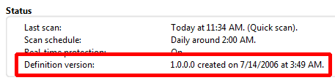
Windows Defender
Also affected by lack of updates
Severely obsolete virus/malware signatures list
No updates since version 1.0.0.0 on 14 July 2006
In order for anti-malware/virus program to be effective, it must have its signatures list regularly updated
So that it can protect the computer from current known threats (Goodrich & Tamassia, 2011)
Blue Ink’s computers failed to detect www.eicar.org pseudo-viruses

Slide 21
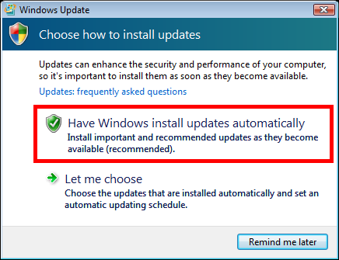
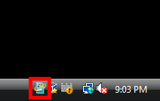
So how can we fix it?
separator
Enable “Automatic Updates” in Vista
Click the highlighted icon in the Notification Area on the right side of the task bar
Then select “Have Windows install updates automatically”

Slide 22
Advantages to updating…
separator
No cost involved when installing service packs or security updates
Most known vulnerabilities will be secure
ie. Auto-run and Active-X Control vulnerabilities will be mitigated
Internet Explorer will be updated to version 9
Windows Defender will be updated with latest signatures
Staff will not require training in use
No changes to user interface

Slide 23
Disadvantages to updating…
separator
Still vulnerable to latest threats until Microsoft patch them
Downloading all updates will cost bandwidth
May take time to download all updates
Internet Explorer 9 still susceptible to various vulnerabilities
Security updates will no longer be received after 11 April 2017
Any vulnerabilities after the last security update will not be resolved

Slide 24
Third-party applications

Slide 25
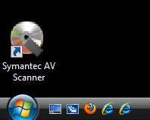
Fake anti-virus
separator
We found a desktop shortcut to a fake anti-virus application
Where did it come from?
Could have been installed through propagation of malware

Slide 26
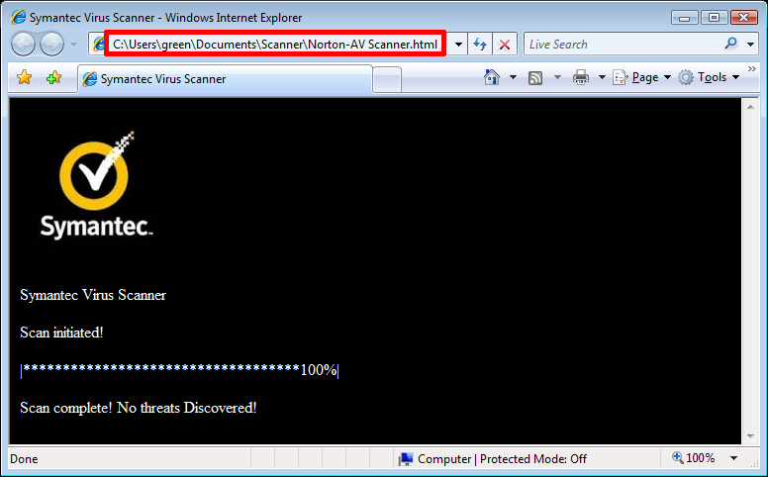

Slide 27
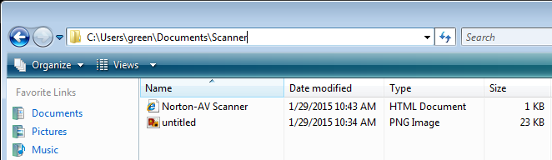
Fake anti-virus
separator
As seen in the previous slide, opening the anti-virus desktop link brings us to a html file attempting to present itself as a legitimate anti-virus program
The browser points to the location of the html file and supporting image file

Slide 28
So how can we fix it?
separator
Delete the desktop shortcut
Delete the Scanner folder containing the html and image file
Install a real anti-virus application
Or stick with Windows Defender

Slide 29
Some anti-virus suggestions…
separator
Avast Enterprise
Bitdefender Enterprise
Kaspersky Business

Slide 30
Other third-party applications
separator
Similar to the operating system, third-party applications will always
Have design flaws
Implementation errors
Which will result in vulnerabilities
For example…

Slide 31
CVE-2014-1522 Remote code execution vulnerability (MITRE, 2014)
separator
A vulnerability in Firefox 8.0
Currently installed on Blue Ink computers
Through a malicious web page, an attacker may:
Execute arbitrary code
Or cause denial-of-service conditions

Slide 32
CVE-2009-3959 Remote code execution vulnerability (SecurityFocus, 2010; SecurityTracker, 2010)
separator
A vulnerability in Adobe Reader 6.0.1
Currently installed on Blue Ink computers
Through a malicious PDF file, an attacker may:
Execute arbitrary code using user’s system privileges
Or cause denial-of-service conditions

Slide 33
CVE-2006-2198 Macro vulnerability (MITRE, 2006)
separator
A vulnerability in OpenOffice.org 1.1.5
Currently installed on Blue Ink computers
Through a malicious OpenOffice document file, an attacker may:
Execute arbitrary macro code using user’s system privileges without prompting user
Macro executes even if macros are disabled

Slide 34
So how can we fix it? Update!
separator
Much like the operating system, security updates are usually provided by third-party application vendors
In order to mitigate as many vulnerabilities as possible, it is important to install these updates for your third-party applications regularly

Slide 35
List of Blue Ink’s third-party applications
Application | Current version | Latest version
Firefox | 8.0 | 37.02
Adobe Reader | 6.0.1 | 10.1.4 *
OpenOffice.org | 1.1.5 | 4.1.1
mIRC | 6.0 | 7.41
* Adobe Reader 10.1.4 is latest version that supports legacy OS like Vista.
Later versions of Adobe Reader no longer support Vista.
Click the latest version number to view the download page.

Slide 36
mIRC Internet Relay Chat client
separator
Internet Relay Chat (IRC) share similar risks of malware propagation as email
Attackers may use social engineering to
Convince victims to view links to malicious web pages or files
Convince victims to open malicious files sent directly through IRCs file-sharing protocol
This report suggests the removal of mIRC on Blue Ink computers to mitigate exposure to such attacks

Slide 37
User practices

Slide 38
Password protection
separator
Blue Ink’s computers automatically log into the user “green” account without authentication
The screensaver is also not password protected
This would allow an attacker to gain access to Blue Ink’s computers and network resources by simply
Turning on the computer
Use the computer while the victim was not at his/her desk

Slide 39
So how can we fix it?
separator
Set a password for user accounts
Password protect the screen saver

Slide 40
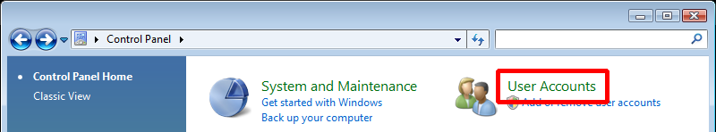
Set a password for the account:
separator
Click “User Accounts” in the Control Panel

Slide 41
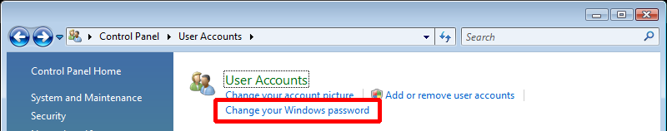
separator
Click “Change your Windows password”

Slide 42
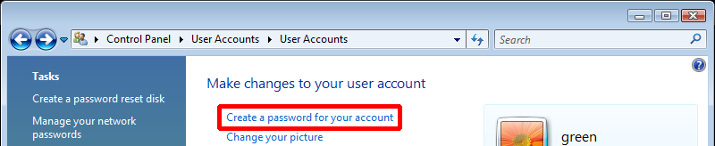
separator
Click “Create password for your account”

Slide 43
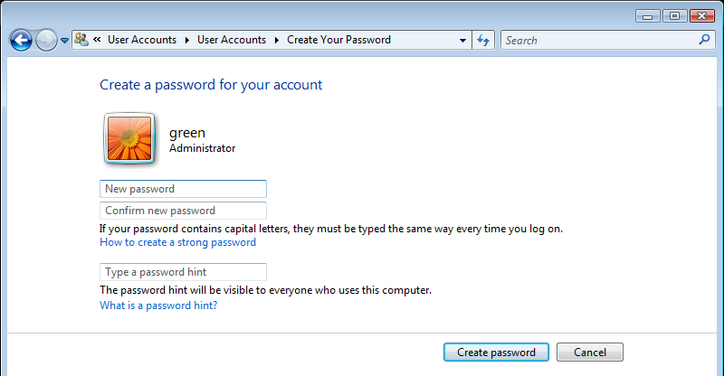
Enter and confirm your new password and click “Create password”
separator

Slide 44
A password is now required…
separator
When the computer is turned on, requiring the user to authenticate before being able to continue

Slide 45
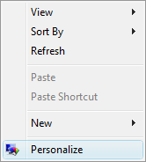
Password protect the screensaver
separator
Right click anywhere on the desktop background
Click “Personalize”

Slide 46
separator
Click “Screen Saver”

Slide 47
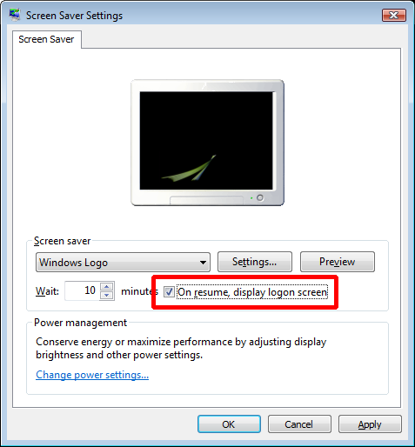
Ensure that the “On resume, display logon screen” checkbox is ticked
separator

Slide 48
Whenever the screen saver is deactivated…
separator
It will prompt the user to log in with their correct password
User must authenticate before gaining access to the computer again

Slide 49
Choosing passwords
separator
Very important
If password too simple
Can easily be guessed with brute-force or dictionary attack
If password too complicated
Too hard to remember
May lead to users writing down their password in plain-text (physical or digital)

Slide 50
Password strategy: Passphrases
separator
Youtube video on next slide demonstrates how to choose a strong, memorable password with passphrases (Oliver & Snowden, 2015)
Give it a moment to load

Slide 51
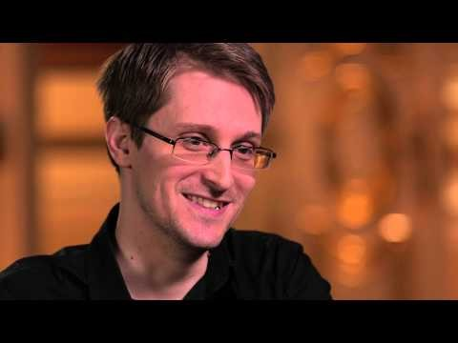

Slide 52
Effective password policy
separator
Goodin (2014) reports that Stanford University’s IT department has implemented an effective password policy
As the length of characters in a password increase, the requirements for specific characters decrease
Promotes longer but more memorable passphrases rather than short complicated passwords
Follow this link for Stanford University’s quick guide which visually explains their password policy
Blue Ink can adapt this password policy for their own requirements

Slide 53
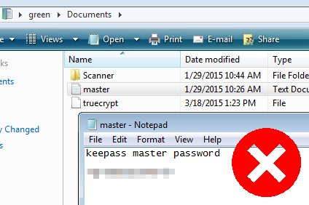
Storing passwords
separator
Never store passwords in plaintext!
Like user “green” did in “My Documents” folder

Slide 54
Writing passwords down
separator
Writing passwords down on paper like a sticky-note also puts your account at risk with attackers
As seen in recent disclosure of French TV network social networking passwords via Youtube (Machkovech, 2015)
Passwords on sticky-notes behind TV reporter during an interview
Local attacker can easily retrieve your written passwords too

Slide 55
So how can we fix it?
separator
Delete all plain-text files containing passwords
Not only text *.txt files
Also PDFs, Excel files etc.
Dispose of written passwords securely
Shred paper
Burn
Use password manager such as Keepass to store passwords
Encrypts / hashes passwords
Use virtual encrypted device to store password/s
ie. Truecrypt
Choose a long, memorable master passphrase

Slide 56
User privileges
separator
Blue Ink’s default users allowed too many privileges
Currently have administrator rights
Admin rights allow a user to
Install/uninstall software/drivers
Make critical system wide changes to settings
ie. Modify other user rights
If a user with admin rights is attacked, the attacker may also inherit these privileges

Slide 57
So how can we fix it?
separator
Reserve administrator accounts for IT support personnel only
Set normal employees as “Standard” users

Slide 58
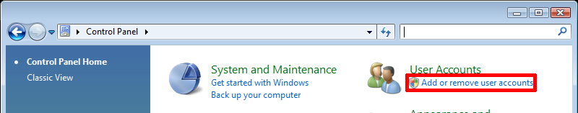
Modifying user privileges:
separator
As an administrator…
Click “Add or remove user accounts” in the Control Panel

Slide 59
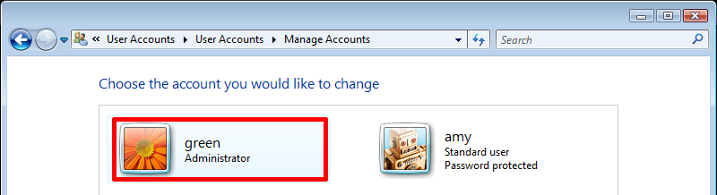
separator
Click the account to be modified

Slide 60
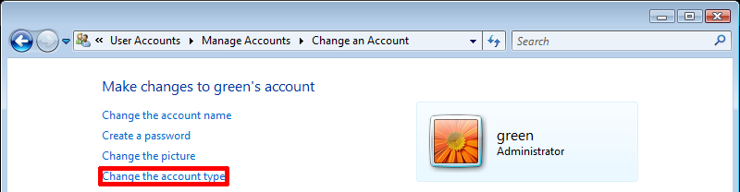
separator
Click “Change the account type”

Slide 61
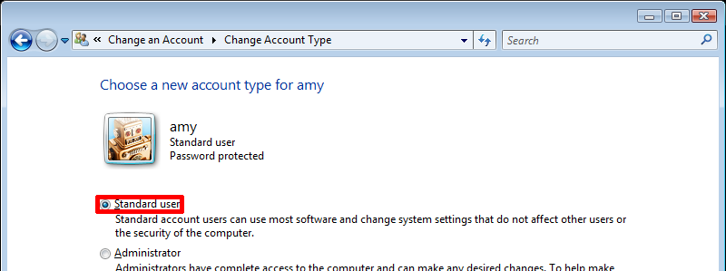
Select “Standard user” then click “Change Account Type”
separator

Slide 62
Advantages
separator
Standard users are not able to install software
May mitigate malware propagation
Require administrator permission to make system changes
May mitigate malware/viruses that make changes to system settings

Slide 63
User Account Control
separator
Assists in protecting the computer by:
Preventing unauthorized changes by a program to the computer (Microsoft, n.d.)
Requires authorization by an administrator to commit changes
Currently disabled in Blue Ink’s computers

Slide 64
So how can we fix it?
separator
Enable UAC

Slide 65
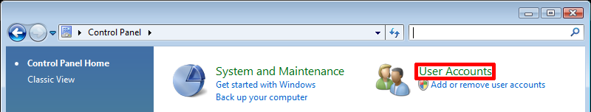
Enabling UAC:
separator
As an administrator…
Click “User Accounts” in the Control Panel

Slide 66
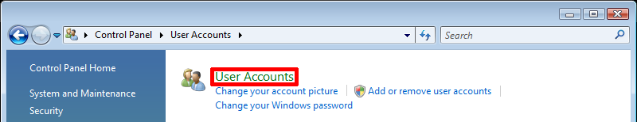
separator
Click “User Accounts” again

Slide 67
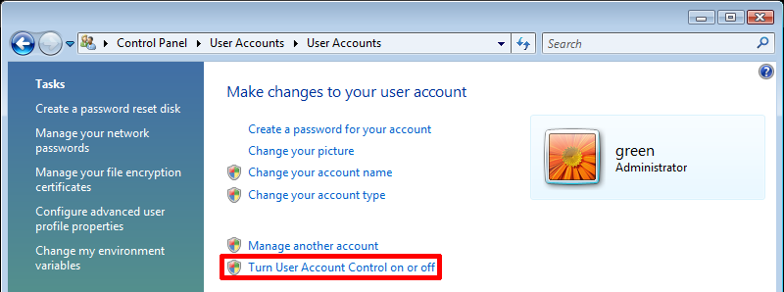
Click “Turn User Account Control on or off”
separator

Slide 68
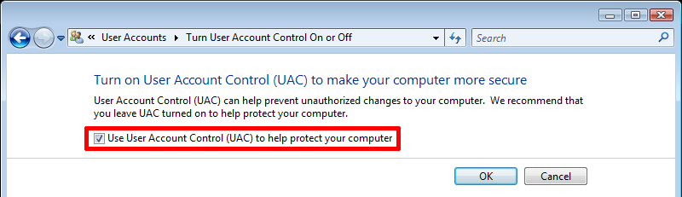
separator
Tick the checkbox and click “OK”

Slide 69
Advantages
separator
Programs that make critical system changes will require authorization from an administrator
Another form of protection against malware that attempt to make system changes silently

Slide 70
Summary

Slide 71
Operating system
Requires upgrading or updating
Mitigates most known vulnerabilities
Newer or unknown vulnerabilities will not be resolved until a later update
Will cause IE and Windows Defender to be updated as well

Slide 72
Third-party applications
Require updates to be installed
Mitigates most known vulnerabilities
Newer or unknown vulnerabilities will not be resolved until a later update
Recommend to uninstall mIRC

Slide 73
User practices
Set account passwords, and password protect screen saver
Use passphrases when choosing a password
Do not write passwords down, or store in plaintext files
Set normal users as “Standard Users”, reserve administrator accounts for IT support staff
Enable UAC

Slide 74
References
Chen, X., & Caselden, D. (2013). New IE Zero-Day Found in Watering Hole Attack - Threat Research - FireEye Inc. Retrieved March 11, 2015, from https://www.fireeye.com/blog/threat-research/2013/11/new-ie-zero-day-found-in-watering-hole-attack.html
Goodin, D. (2014). Stanford’s password policy shuns one-size-fits-all security | Ars Technica. Ars Technica. Retrieved April 30, 2015, from http://arstechnica.com/security/2014/04/25/stanfords-password-policy-shuns-one-size-fits-all-security/
Goodrich, M. T., & Tamassia, R. (2011). Introduction to computer security. Boston: Pearson.
Microsoft. (2013). Microsoft Security Bulletin MS13-090 - Critical. Retrieved March 11, 2015, from https://technet.microsoft.com/library/security/ms13-090?f=255&MSPPError=-2147217396
Microsoft. (2014). Windows lifecycle fact sheet - Windows Help. Microsoft. Retrieved February 27, 2015, from http://windows.microsoft.com/en-au/windows/lifecycle
Microsoft. (2015). Microsoft Support Lifecycle. Microsoft. Retrieved February 27, 2015, from http://support.microsoft.com/lifecycle/search/default.aspx?alpha=Vista
Microsoft. (n.d.-a). Internet Explorer system requirements IE11. Microsoft. Retrieved April 19, 2015, from http://windows.microsoft.com/en-au/internet-explorer/ie-system-requirements#ie=ie-11
Microsoft. (n.d.-b). What is User Account Control? - Windows Help. Retrieved March 14, 2015, from http://windows.microsoft.com/en-au/windows/what-is-user-account-control#1TC=windows-vista
MITRE. (2006). CVE - CVE-2006-2198. cve.mitre.org. Retrieved March 11, 2015, from http://cve.mitre.org/cgi-bin/cvename.cgi?name=CVE-2006-2198
MITRE. (2014). CVE - CVE-2014-1532. cve.mitre.org. Retrieved March 18, 2015, from http://cve.mitre.org/cgi-bin/cvename.cgi?name=CVE-2014-1532
Moran, N., Scott, M., Vashisht, S. O., & Haq, T. (2013). Operation Ephemeral Hydra: IE Zero-Day Linked to DeputyDog Uses Diskless Method | Threat Research | FireEye Inc. Retrieved March 11, 2015, from https://www.fireeye.com/blog/threat-research/2013/11/operation-ephemeral-hydra-ie-zero-day-linked-to-deputydog-uses-diskless-method.html

Slide 75
References
Oliver, J., & Snowden, E. (2015). [LastWeekTonight] Last Week Tonight with John Oliver: Edward Snowden on Passwords. Retrieved May 6, 2015, from https://www.youtube.com/watch?v=yzGzB-yYKcc
Ozkan, S. (2013). CVE-2013-3918 : The InformationCardSigninHelper Class ActiveX control in icardie.dll in Microsoft Windows XP SP2 and SP3, Windows Server. CVE Details. Retrieved March 11, 2015, from http://www.cvedetails.com/cve/CVE-2013-3918/
Ozkan, S. (2015). Microsoft Windows Vista : List of security vulnerabilities. CVE Details. Retrieved February 27, 2015, from http://www.cvedetails.com/vulnerability-list/vendor_id-26/product_id-9591/Microsoft-Windows-Vista.html
Ozkan, S. (n.d.). Versions of Microsoft Internet Explorer : Versions and number of related security vulnerabilities. CVE Details. Retrieved April 18, 2015, from http://www.cvedetails.com/version-list/26/9900/1/Microsoft-Internet-Explorer.html
SecurityFocus. (2008). Microsoft Windows NoDriveTypeAutoRun Automatic File Execution Vulnerability. SecurityFocus. Retrieved March 7, 2015, from http://www.securityfocus.com/bid/28360
SecurityFocus. (2010). Adobe Reader and Acrobat U3D Support Remote Code Execution Vulnerability. Retrieved March 11, 2015, from http://www.securityfocus.com/bid/37756/info
SecurityTracker. (2010). Adobe Acrobat and Adobe Reader Flaws Lets Remote Users Execute Arbitrary Code and Deny Service - SecurityTracker. SecurityTracker. Retrieved March 11, 2015, from http://www.securitytracker.com/id?1023446
Wilson, T. (2013). New IE Vulnerability Found In The Wild; Sophisticated Web Exploit Follows. darkreading.com. Retrieved March 11, 2015, from http://www.darkreading.com/new-ie-vulnerability-found-in-the-wild-sophisticated-web-exploit-follows/d/d-id/1140858?

